Slide 1
Paediatric Clinical Psychology
Derbyshire Children’s at the Royal Derby Hospital
Dr Emma Vanter, Specialist Clinical Psychologist. 16/5/2024

Slide 2
Department of Clinical Psychology (Children’s)
Paediatric Clinical Psychology
Autism Assessment
(+ Intervention)
Complex Behaviour Service
Positive Behaviour Service
Youth Justice Psychology

Slide 3
Referral Pathways
Paediatric Clinical Psychology – via SPOA (usually from health professionals) Up to age 16*
Autism team - via Neurodevelopmental Pathway
Complex Behaviour Service (CBS) – via SPOE (for children with Intellectual/Learning Disability)
Positive Behaviour Service (PBS) – for inpatients at Derbyshire Children’s Hospital
Youth Justice Psychology – no external referrals accepted

Slide 4
Paediatric Clinical Psychology
Paediatrics
Term used to mean medical care for babies, children, and adolescents
Paediatric Clinical Psychology
Emotional wellbeing support for young people (and their families) who have medical/ physical health symptoms or diagnoses.

Slide 5
Physical health symptoms / diagnosis can affect
How I look
How I feel physically
My energy levels
My behaviour
How I feel emotionally
My confidence
Some days / times more than others
My concentration – what’s on my mind
My vulnerability
My family
My identity
My independence
My hopes and dreams
My friendships
My learning
My attendance
My sensory abilities
What I can and can’t do
What I can and can’t cope with

Slide 6
Expected ----------------- Clinically significant impacts impacts
It takes time to adjust to new diagnosis / treatments
Sometimes feeling upset about it
Symptoms sometimes getting in the way
Okay most of the time, able to live well in spite of diagnosis/symptoms
Effects of health condition getting in the way of ‘normal life’ +++
Loss of self, loss of positive mood, intrusive thoughts or anxieties related to health symptoms/diagnosis
Falling behind socially or academically as a result of physical health symptoms or care needs
Parent/professional concerns

Slide 7
Example: Concussion after falling off bike
Getting headaches at the end of the school day for a couple of weeks, struggling to get homework done.
Daily headaches six months on, impacting ++ on school attendance. Worrying about attending lessons due to having fallen behind. Getting anxious about going back, feeling too nauseous to try. Family concerned this might be permanent. No medical reason for headaches identified.

Slide 8
Clinical Psychology involvement you might encounter:
Time off - appointments usually hospital based, 1-2 hours (can be tiring)
Sometimes appointments might need to be at school
School observations
School conversations / meetings
TAF / Professionals meetings
Ideas to try (home / school / both)
Psychometric assessments

Slide 9
School observations
A “visitor to the school come to see how we do things”.
Structured time (main class, without support)
Supported learning (if provided)
Less / Un structured time (lunch, PE, etc)
* The observer will not have met the child!

Slide 10
Psychometric Assessment or Therapy Session in school
Quiet, confidential space
May need a table
May help to have a familiar adult available/present
To avoid favourite times if possible!

Slide 11
Psychometric Assessments
Also called “Cognitive Assessment”, “IQ Assessment” or “Neuropsychological Assessment”
Puzzles and questions to understand areas of cognitive strength and difficulty
Information from school helpful to ‘triangulate’
- Observation (nursery, primary)
- Conversation
- Questionnaires

Slide 12
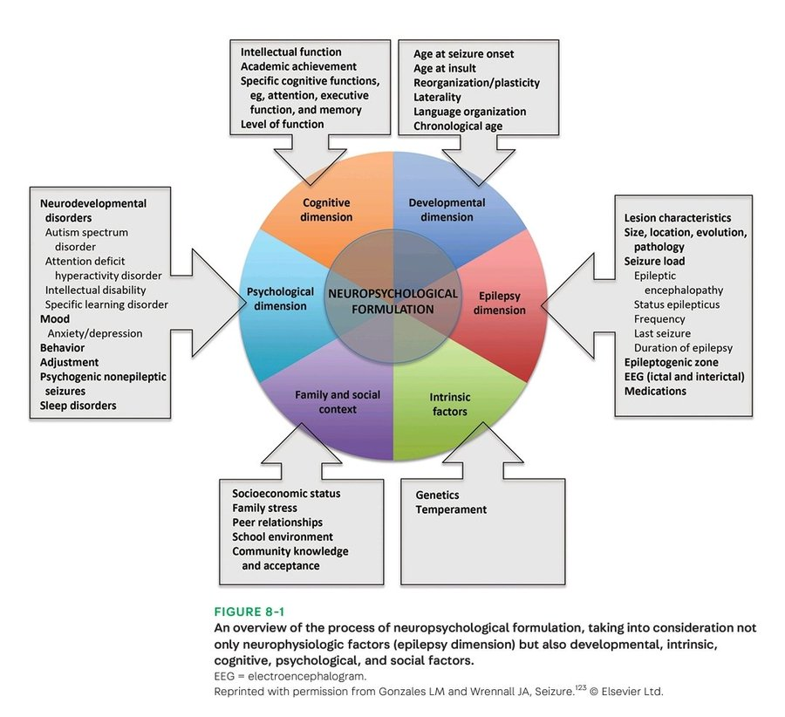
Multi- faceted
Assessment to
make sense of
a young person’s
difficulties.
To understand
what might be
helpful

Slide 13
SO MANY QUESTIONNAIRES!!!!! (Thank you!!!!!)

Slide 14
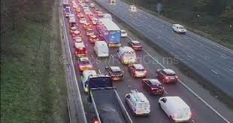
Communication and Feedback
Confidentiality
Safeguarding
How are things from your end?
What does the young person and their family choose / wish to share with school?
Possible reports / review meetings

Slide 15
Scope of involvement
Might be open to more than one psychologist or psychology team at once
Might be brief, 1-6 sessions
Might be indirect work, or direct work
Might be longer term e.g. over transitions
Diabetes / Cystic Fibrosis – may have contact via clinics until move to adult services

Slide 16
Case Example
Kiran age 10 has epilepsy, had surgery for this 6 months ago. He has not had any seizures since the surgery.
Paediatrician refers to SPOA: the family is concerned, Kiran is falling behind at school and seems low in mood. His behaviour has deteriorated.
When he gets home from school he just wants to go to his room. He is refusing to do his physiotherapy exercises. He doesn’t see friends.
Kiran is ‘clingy’ in the mornings and doesn’t want to leave his parents.

Slide 17
Initial Assessment
Kiran and his parents come to the hospital for an initial assessment. This lasts 90 minutes. Some time is spent with Kiran, then Kiran goes to another room to play and his parents continue to talk to the psychologist.
The psychologist and the family together start to make sense of what might be happening.

Slide 18
Formulation / things to make sense of
Kiran yawns a lot during the appointment. He is sleeping long hours at night.
Kiran feels too tired to do his physio (or anything else) after school.
Family and Kiran’s expectation of life after surgery.
Medical records and the reasons for the surgery – e.g. MRI findings

Slide 19
Intervention might be…
‘Psychoeducation’ to family, to Kiran
Talking / meeting with school to understand concerns
Working with Kiran around his identity, and any anxieties he might have (weekly/ fortnightly sessions)
Thinking with family and/or school and physiotherapy service about any changes that might help. Try these, and review.
Cognitive assessment to understand areas of difficulty for Kiran. Report with recommendations.

Slide 20
ANY QUESTIONS?

